Slide 1



MARKET ANALYSIS
Team ID: PTID-CDA-DEC-24-283
Project ID: CDACL-006
Project Name: Market Analysis
(rashireddy981212@gmai.com,
neets.2012@gmail.com)

Slide 2
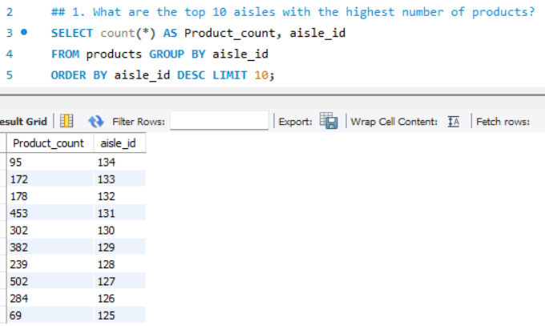
1) What are the top 10 aisles with the highest number of products? Statement Explanation: The above SELECT Statement retrieves all columns and rows from the movies table, providing detailed information about every movie in the dataset as shown in the result.

Slide 3
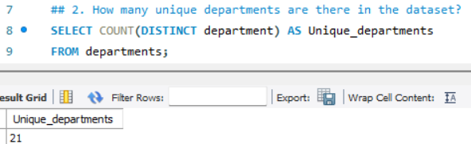
2) How many unique departments are there in the dataset? Statement Explanation: The above SELECT Statement retrieves COUNT(DISTINCT department_id) to count unique department IDs in the departments table as shown in the result.

Slide 4
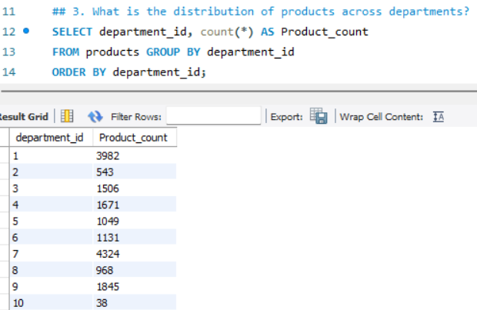
3) What is the distribution of products across departments? Statement Explanation: The above SELECT Statement retrieves count products grouped by department_id. Sort by department_id as shown in the result.

Slide 5
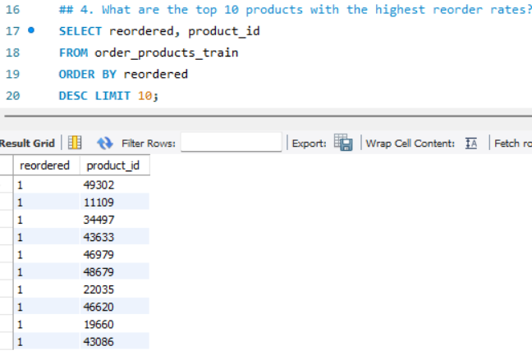
4) What are the top 10 products with the highest reorder rates? Statement Explanation: The above SELECT Statement retrieves calculated average reorder rate (AVG(reordered)) for each product_id. Sort by reorder rate and take the top 10 as shown in the result.

Slide 6
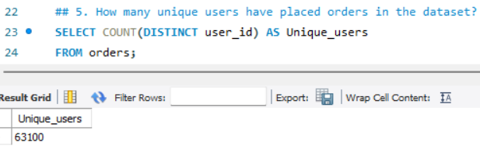
5) How many unique users have placed orders in the dataset? Statement Explanation: The above SELECT Statement retrieves COUNT(DISTINCT user_id) to count unique users in the orders table as shown in the result.

Slide 7
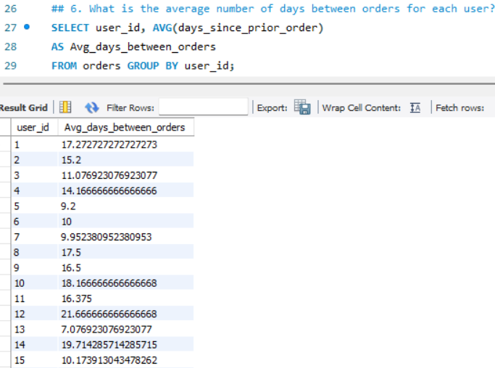
6) What is the average number of days between orders for each user? Statement Explanation: The above SELECT Statement retrieves group by user_id and compute the average (AVG(days_since_prior_order)) as shown in the result.

Slide 8
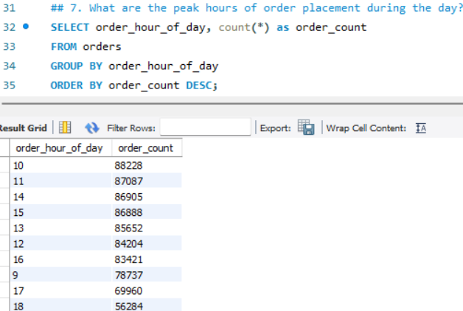
7) What are the peak hours of order placement during the day? Statement Explanation: The above SELECT Statement retrieves count orders for each hour (order_hour_of_day). Sort by order count in descending order as shown in the result.

Slide 9
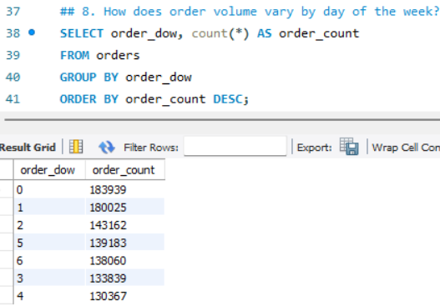
8) How does order volume vary by day of the week? Statement Explanation: The above SELECT Statement retrieves count orders for each order_dow. Sort by order count in descending order as shown in the result.

Slide 10
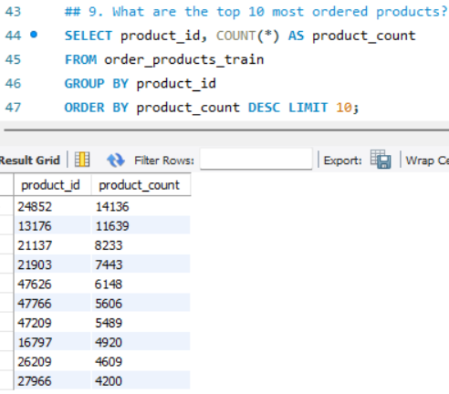
9) What are the top 10 most ordered products? Statement Explanation: The above SELECT Statement retrieves count orders for each product_id. Sort by order count and take the top 10 as shown in the result.

Slide 11
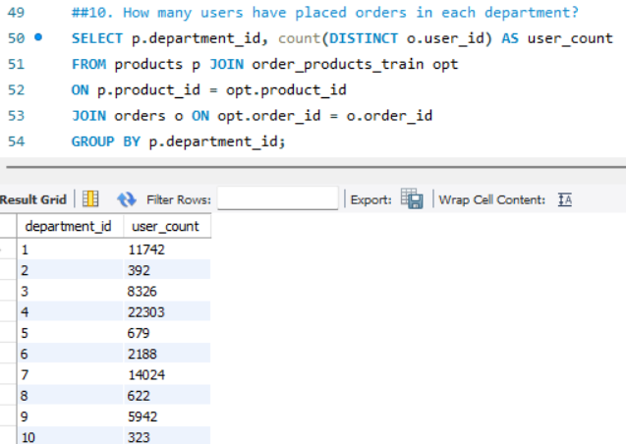
10) How many users have placed orders in each department? Statement Explanation: The above SELECT Statement retrieves join of products from order_products_train, and orders tables. Group by department_id and count unique user_id as shown in the result.

Slide 12
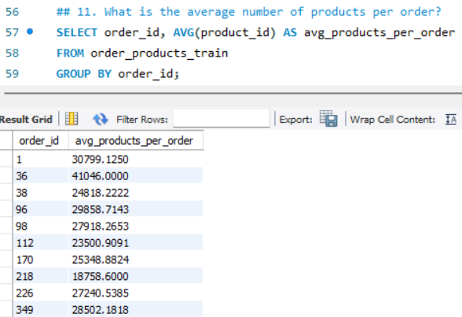
11) What is the average number of products per order? Statement Explanation: The above SELECT Statement retrieves group by order_id and compute the average number of products as shown in the result.

Slide 13
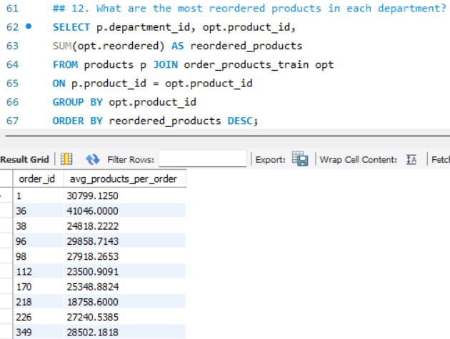
12) What are the most reordered products in each department? Statement Explanation: The above SELECT Statement retrieves join of products and order_products_train, group by department_id and product_id, and sum reorders (SUM(opt.reordered)) as shown in the result.

Slide 14
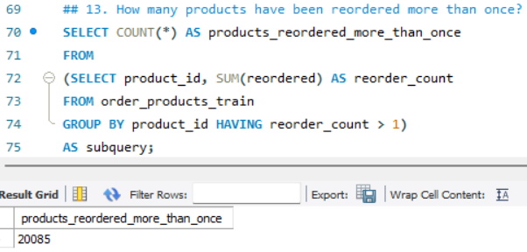
13) How many products have been reordered more than once? Statement Explanation: The above SELECT Statement retrieves filtered products with SUM(reordered) > 1 and count them as shown in the result.

Slide 15
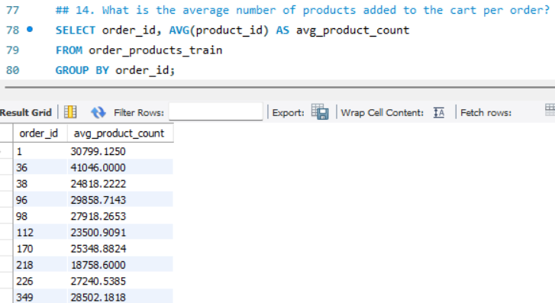
14) What is the average number of products added to the cart per order? Statement Explanation: The above SELECT Statement retrieves group by order_id and compute the average number of products as shown in the result.

Slide 16
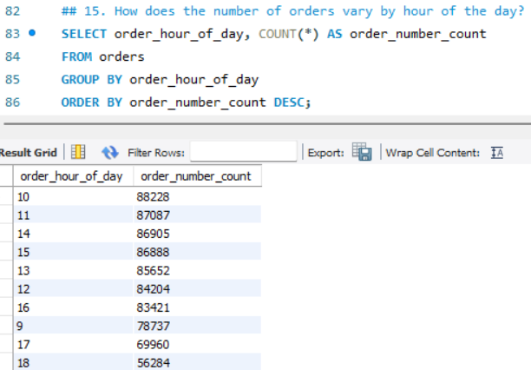
15) How does the number of orders vary by hour of the day? Statement Explanation: The above SELECT Statement retrieves count orders grouped by order_hour_of_day as shown in the result.

Slide 17
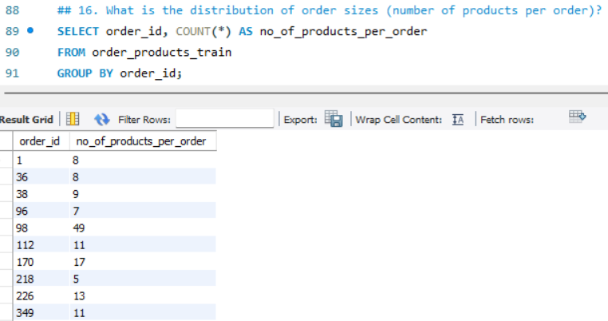
16) What is the distribution of order sizes (number of products per order)? Statement Explanation: The above SELECT Statement retrieves count products grouped by order_id as shown in the result.

Slide 18
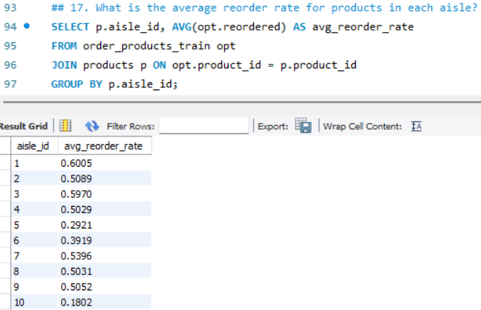
17) What is the average reorder rate for products in each aisle? Statement Explanation: The above SELECT Statement retrieves join of products and order_products_train. Group by aisle_id and compute AVG(reordered) as shown in the result.

Slide 19
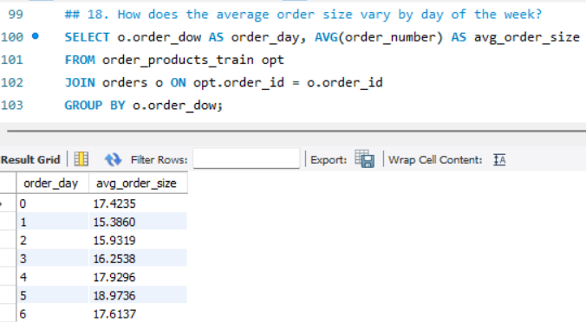
18) How does the average order size vary by day of the week? Statement Explanation: The above SELECT Statement retrieves join of orders and order_products_train, group by order_dow, and compute the average order size as shown in the result.

Slide 20
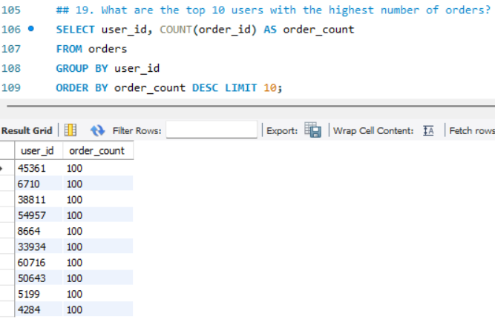
19) What are the top 10 users with the highest number of orders? Statement Explanation: The above SELECT Statement retrieves group by user_id and count orders. Sort and take the top 10 as shown in the result.

Slide 21
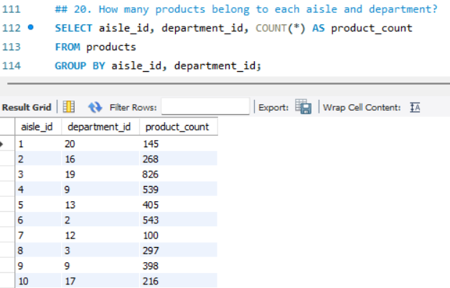
20) How many products belong to each aisle and department? Statement Explanation: The above SELECT Statement retrieves group by aisle_id and department_id and count products as shown in the result.

Slide 22


